Slide 1

PRODUCT INTRODUCTION
WEB5 Introduction
Nov 13, 2023
https://web5.ink/

Slide 2
CONTENTS
Project introduction
Team Introduction
Product Highlights
project Vision
INTRODUCED
TEAM
HIGHLIGHT
VISION

Slide 3

Project introduction
No.1
Introduction of personnel
Our members
No.2
Composed of outstanding students, former employees of major Internet companies, and experienced blockchain engineers.
Project Description
No.3
The members have extensive industry experience, as well as professionalism, which is a great guarantee for our program.
Roadmap

Slide 4

Introduction to the Web5 platform
Goal:
Web2 + Web3 perfect combination of platforms,
guide newcomers into the Web3 world, training excellent Web3 developers,
to solve the project side of the problem,
the future has more plans!

Slide 5
Roadmap
Exporting courses externally,
negotiating sponsorships,
working with great platforms
Developing AI tools, developing intent tools,
and extending security.
Giving back to the industry
Build a basic platform, improve specialized courses,
and absorb quality lecturers
Building multimedia platforms,
organizing educational events, incubating projects
Phase II
Phase IV
refinement
evolve
Phase I
Phase III
set in motion
escalate

Slide 6
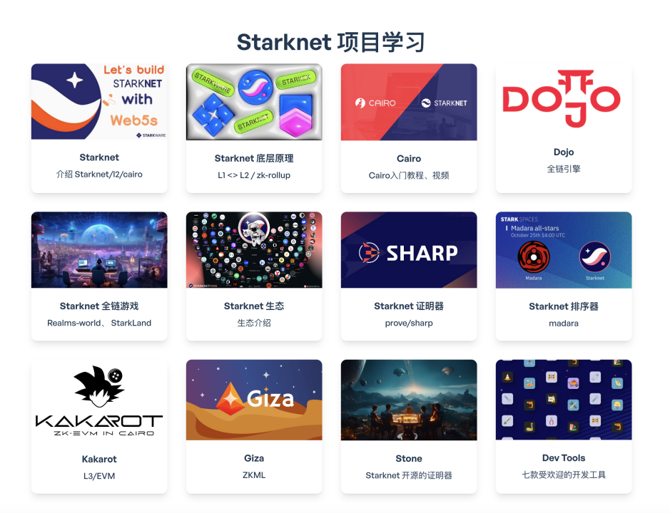
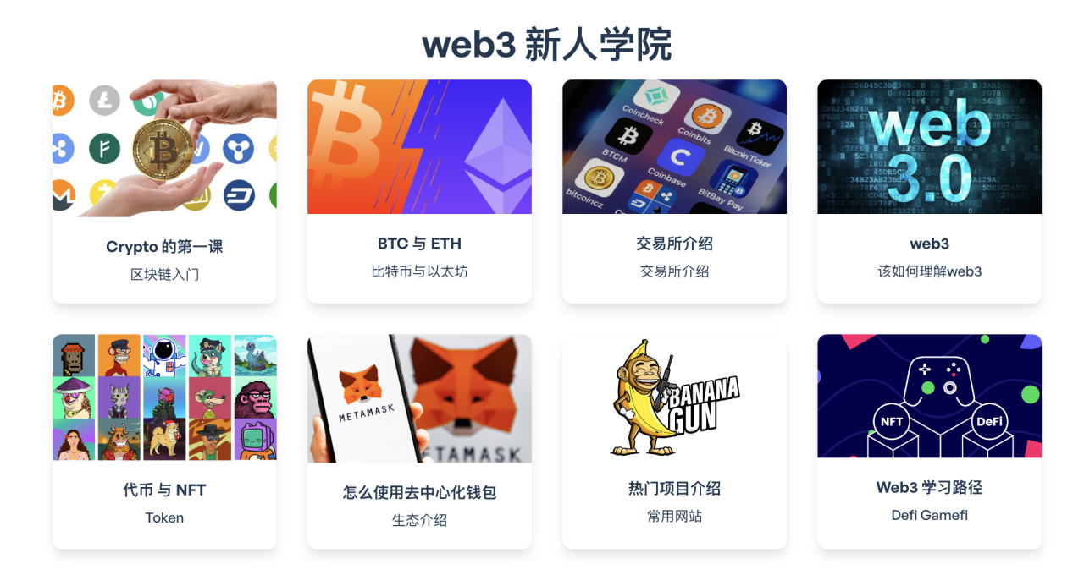
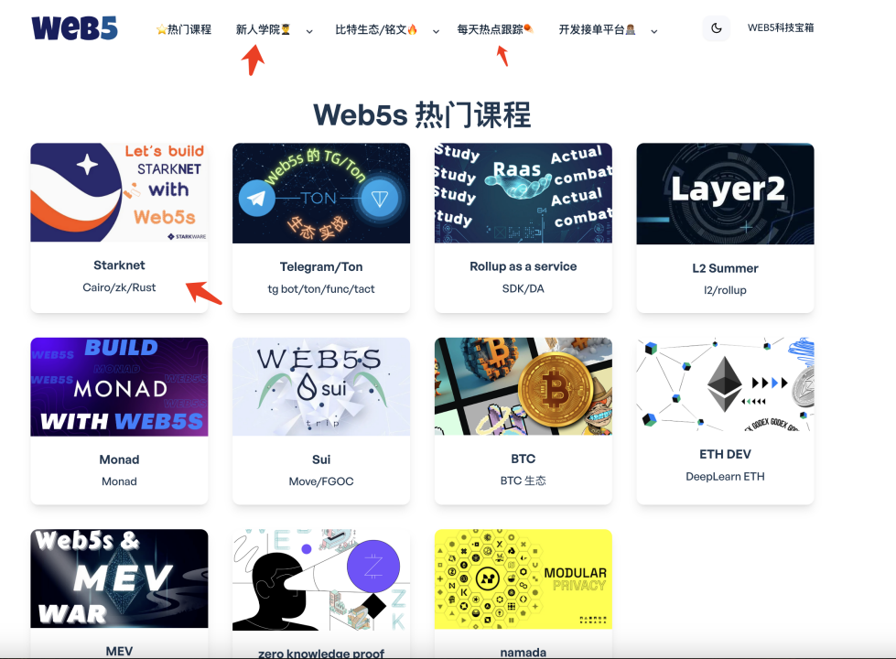
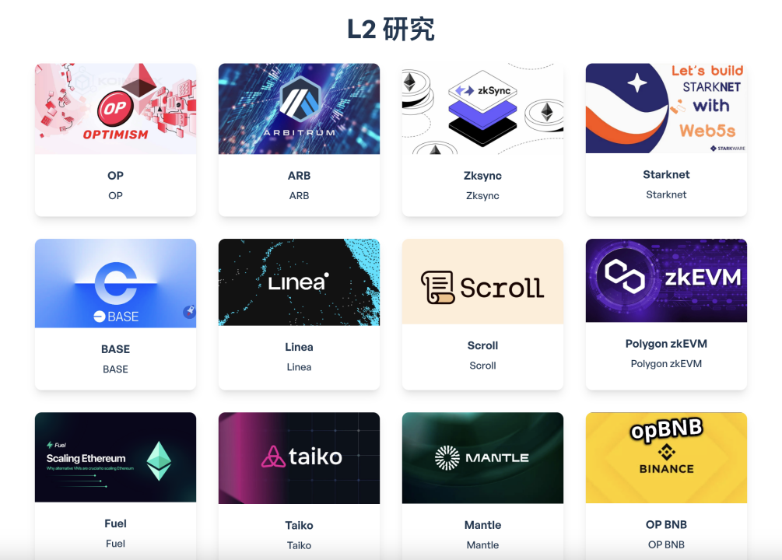
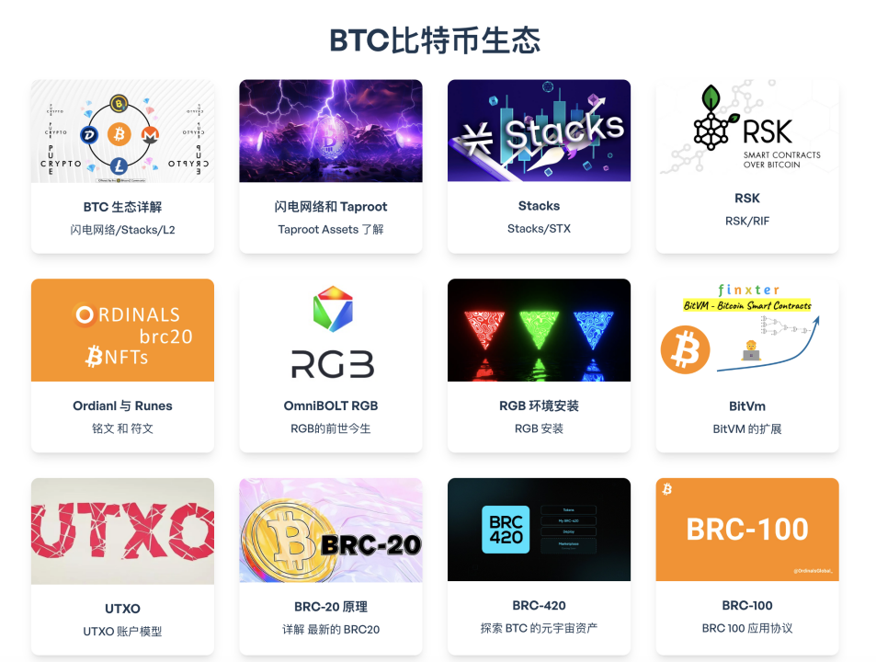
Project Showcase

Slide 7
Data after one week online
Post-launch visits

Slide 8

Obtaining cooperation
Already cooperated with Chainbase and look forward to more cooperation in the future!

Slide 9
Our Advantages
Extensive experience
Excellent team
Crypto native
Chinese language area
with deep roots
High community
visibility
Extensive product
experience

Slide 10
Our Vision
become a comprehensive platform that integrates science, education and development.
Become influential in Chinese and non-Chinese areas. Explore more possibilities with AI

Slide 11
THANK YOU

